Slide 1
Chapter 5 One-dimensional groundwater flow
Governing partial differential equation
Aquifers of half-infinite extent
Driving sinusoidal waves ast x=0
Sudden head changes at x=0
Aquifers of limited extent (strip of land of given width)
Groundwater basins and their characteristics

Slide 2
Derivation of basic partial differential equation (which is a water budget on infinitesimal scale)

Slide 3
With constant aquifer thickness D and zero recharge (n=0)
Let the meaning of this equation sink in.
It becomes obvious when you consider a small aquifer slice of width 𝛥x.
Integrate over the distance x to x + 𝛥x:
Showing the net inflow on the left equaling the storage on the right

Slide 4
Analytical solutions to the partial differential equation (PDE)
Must fulfill the PED
Must fulfill the innitial condition
Must fulfill the boundary conditions
One set of solutions have the form
Cycle time:

Slide 5
Proof that the solution is correct How?
Fill it into the PDE
Then see that
And, therefore, the solution is
Boundaries
Envelopes
c can be any constant

Slide 6
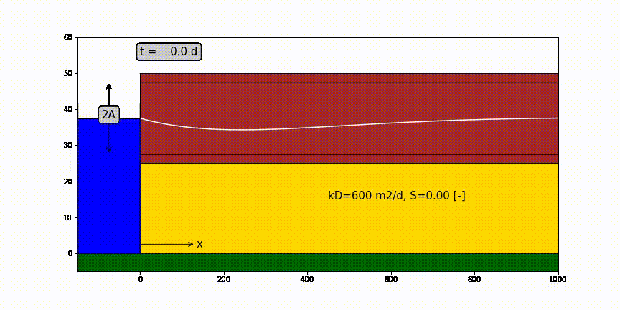
One-dimensional half infinite confined aquifer bounded by surface water at x=0 in which water level fluctuation like a sine.

Slide 7
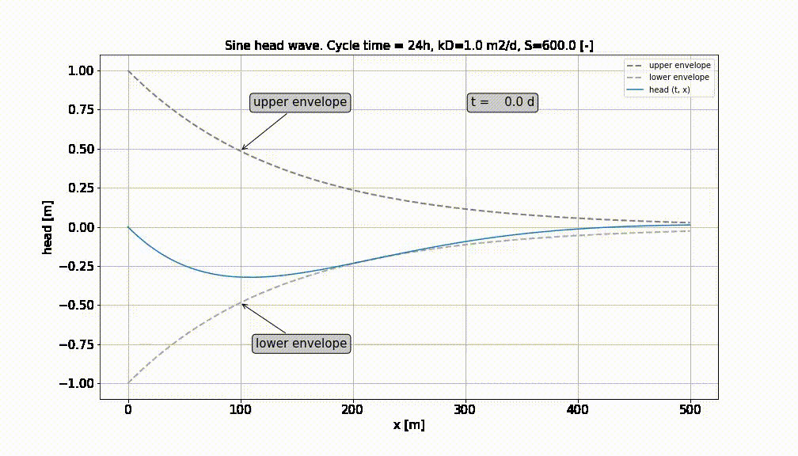

Slide 8
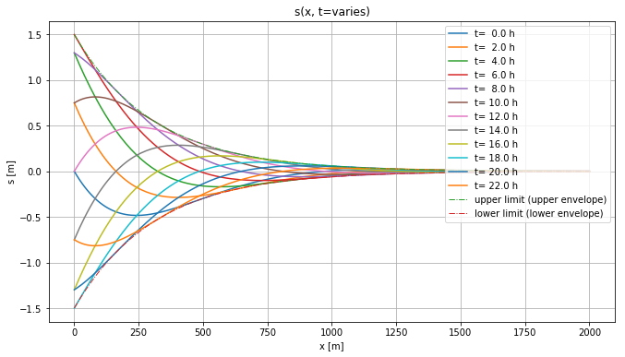
Head in aquifer at different times. Always stays within envelopes

Slide 9
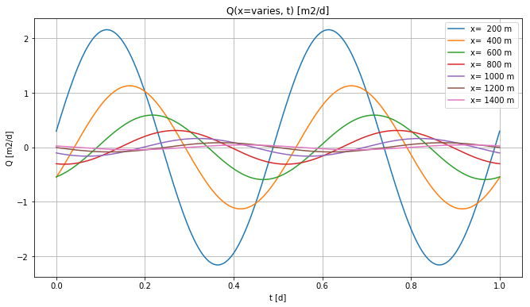
Heads at different x

Slide 10
Head and discharge in the aquifer
Head:
Discharge:

Slide 11
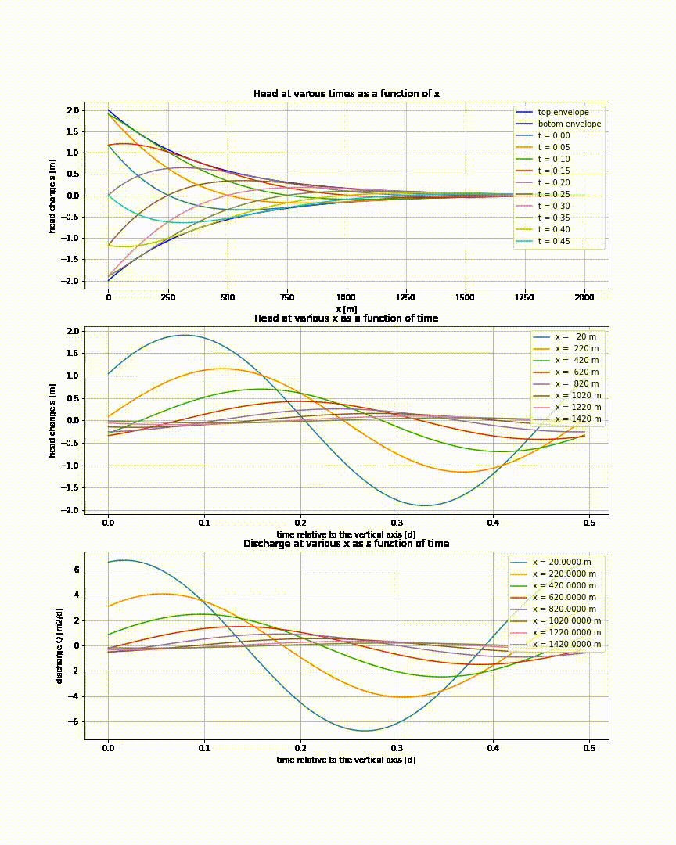

Slide 12
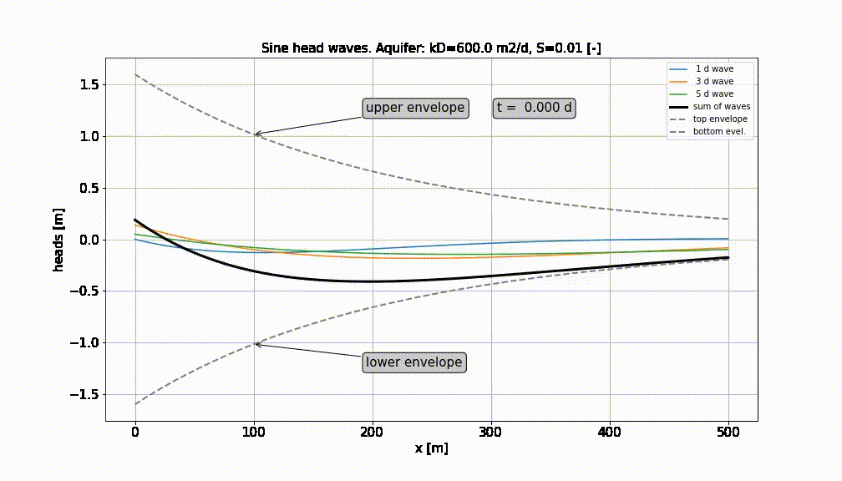
Superpostion of a number of sine-waves

Slide 13
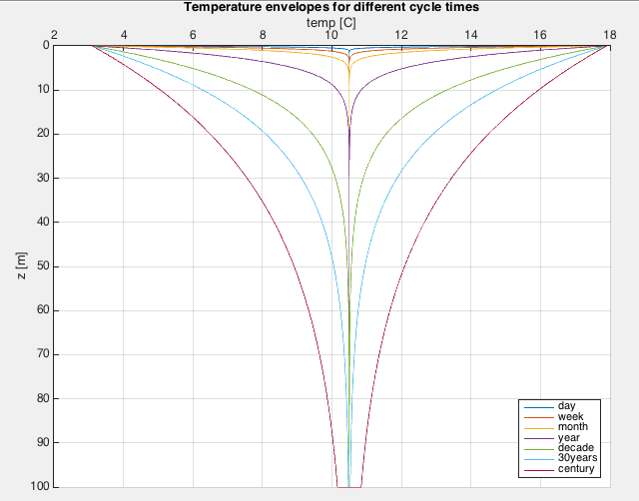
Sec. 5.3.2: Temperature fluctuations

Slide 14
Exercises and questions
See section 5.3.4
See old exams bundle

Slide 15
Sec. 5.4 sudden head change at x=0
Basins of half-infinite extent (as before)
Same partial differential equation
Different solution

Slide 16
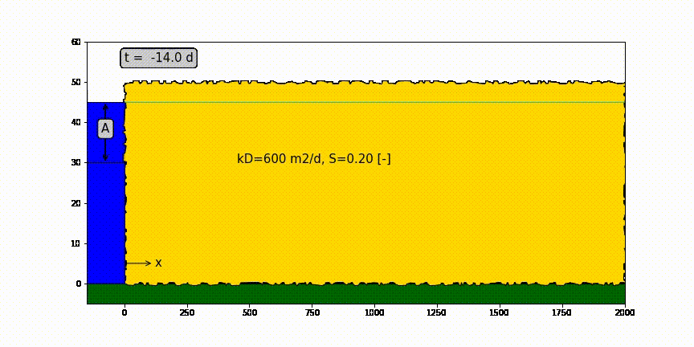
Head change due to sudden head change at x=0

Slide 17
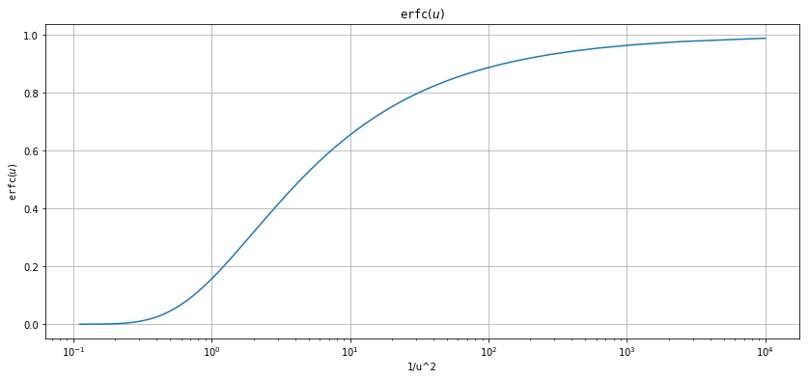
erfc(u) as function of 1/u

Slide 18
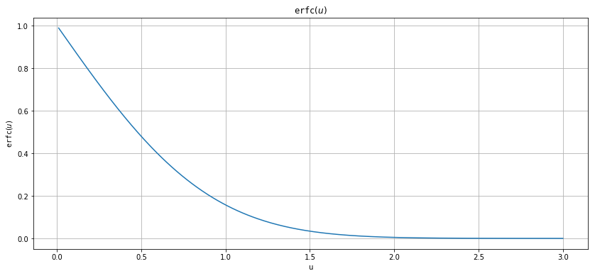
erfc(u) as a function of u

Slide 19
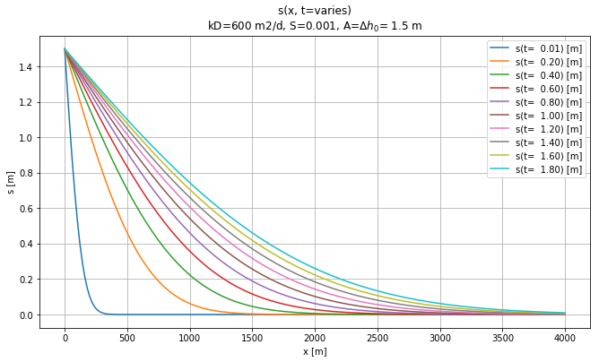
Effect of sudden rise of head at x=0 and t=0

Slide 20
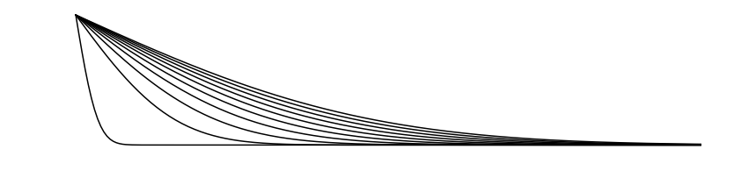
Head change due to sudden head change at x=0
h(x,0)
Drawdown progression
Water table h(x, t) declines with time (= drawdown)
h(x,∞)

Slide 21
Confined aquifer of half-infinite extent with sudden head change A [m] at x=0 and t=0
A
kD
S
x

Slide 22
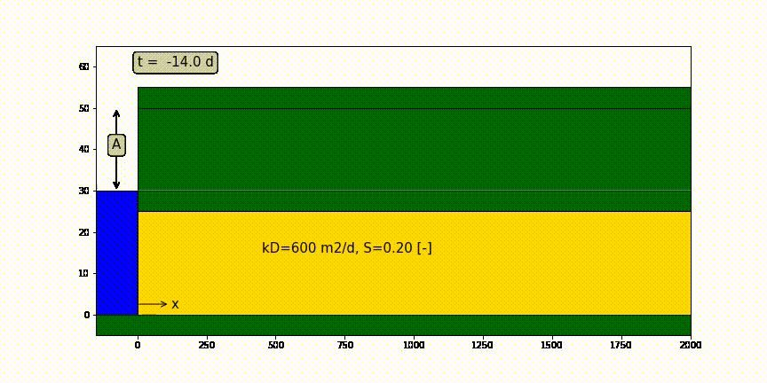
Confined aquifer of half-infinite extent with sudden head change A [m] at x=0 and t=0

Slide 23
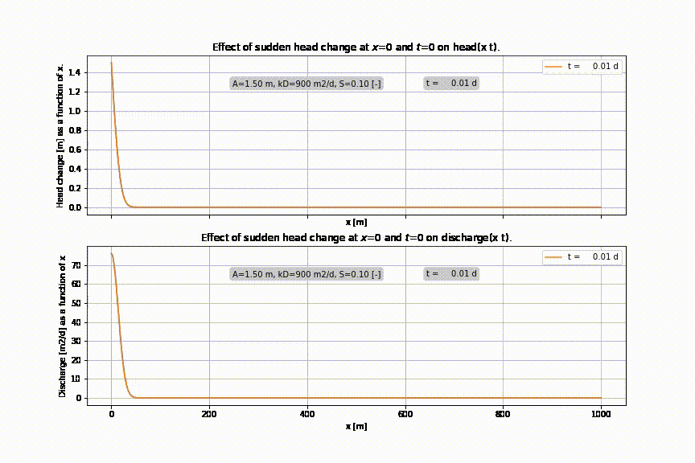

Slide 24
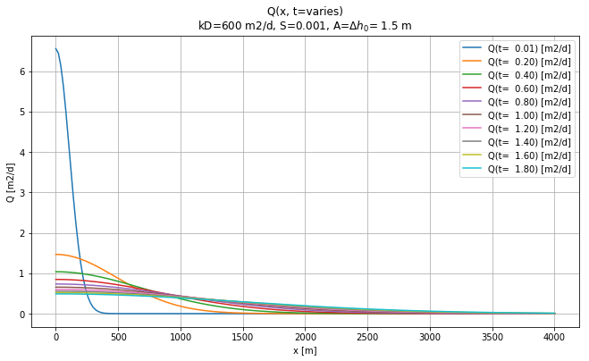
Discharge at different time due to sudden head change at x=0

Slide 25
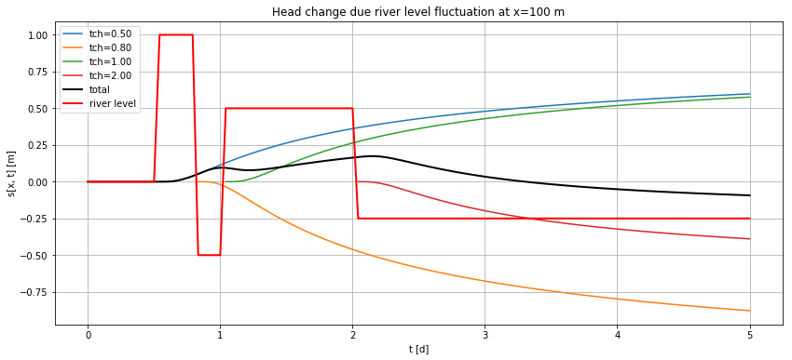
Varying water level at x=0 → do superposition in time

Slide 26
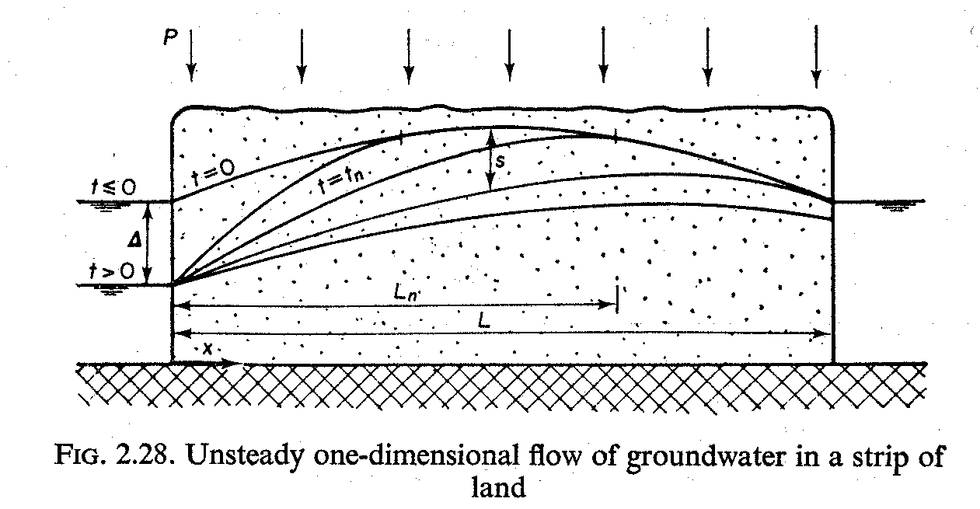
Aquifer is bounded between two fixed-head boundaries, what to do?

Slide 27
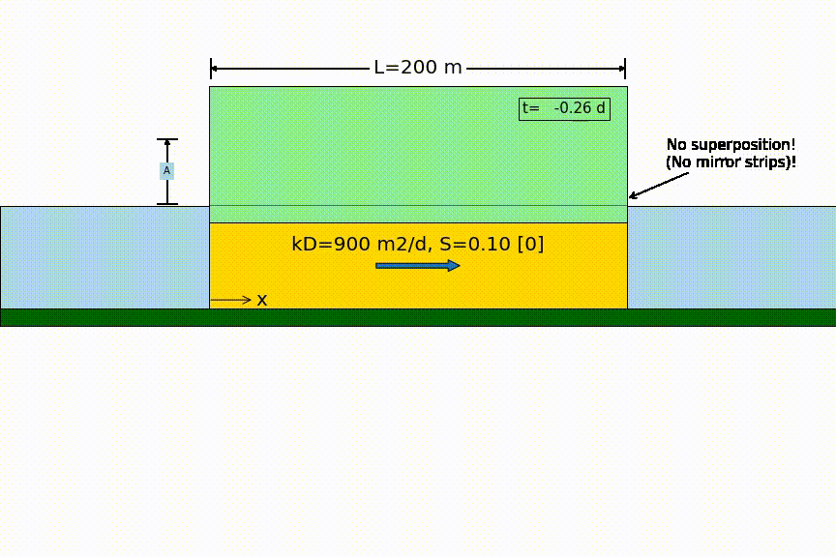
Head changes suddenly on one side

Slide 28
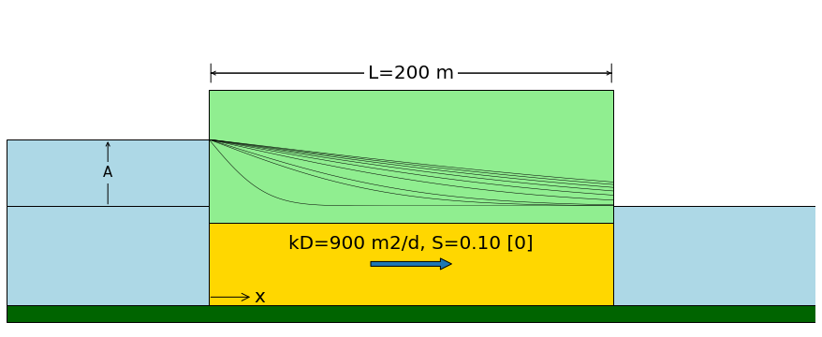
Head changes suddenly on one side
Sudden water level change by A
no longer zero !

Slide 29
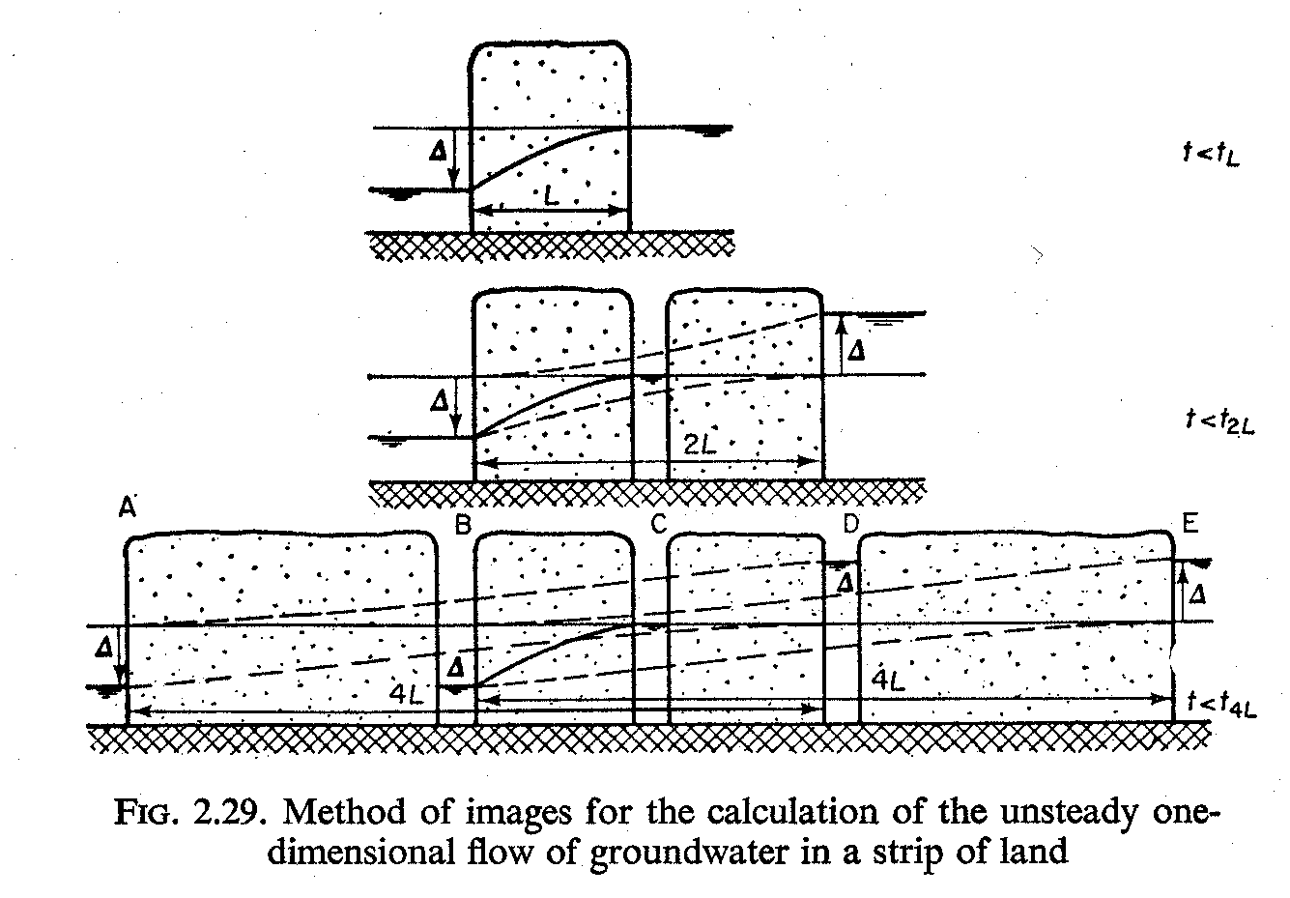
Aquifer is bounded between two fixed-head boundaries→ superposition in space

Slide 30
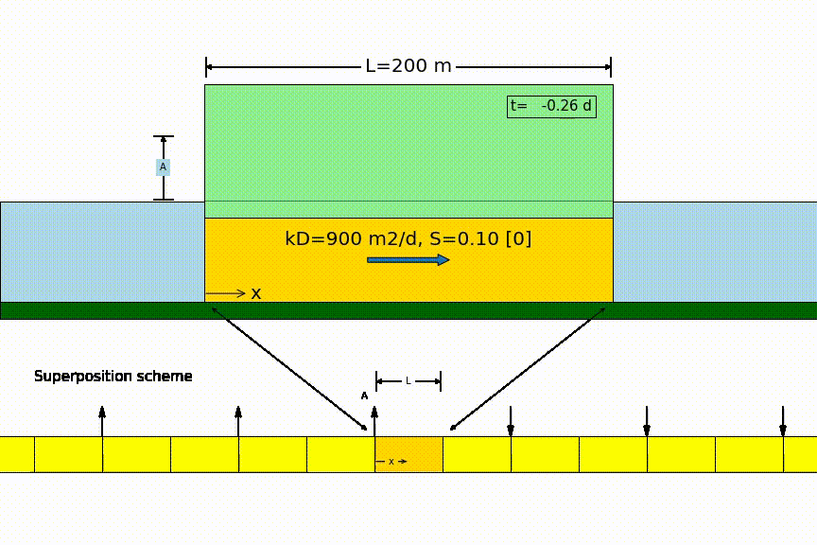
Head changes suddenly on one side

Slide 31
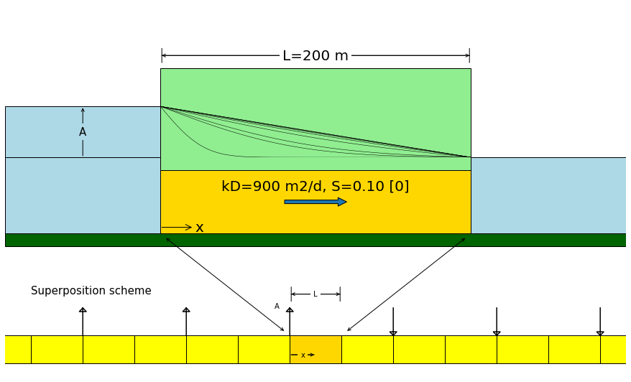
Head changes suddenly on one side
zero

Slide 32
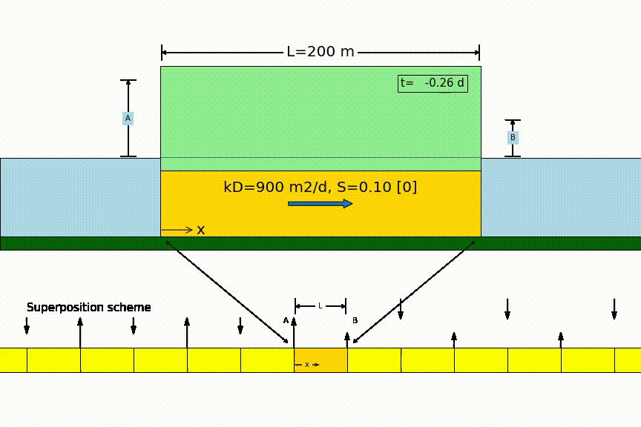
Head changes suddenly on two sides

Slide 33
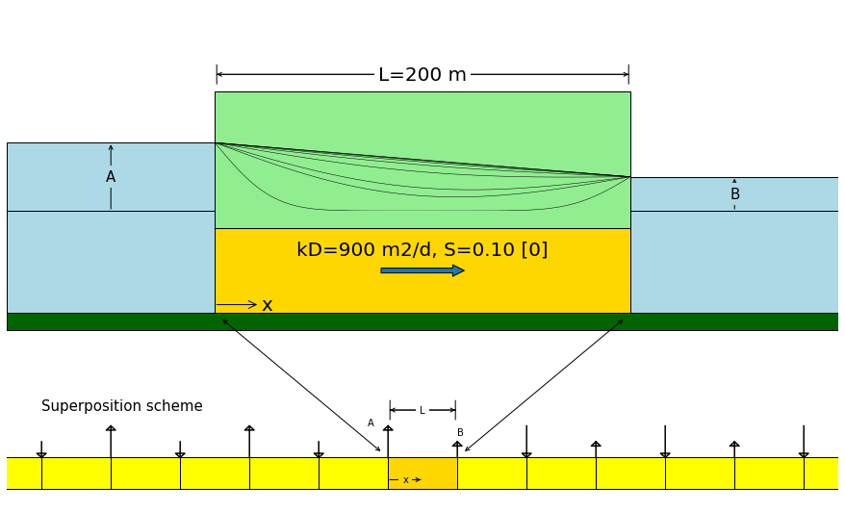
Head changes suddenly on both sides

Slide 34
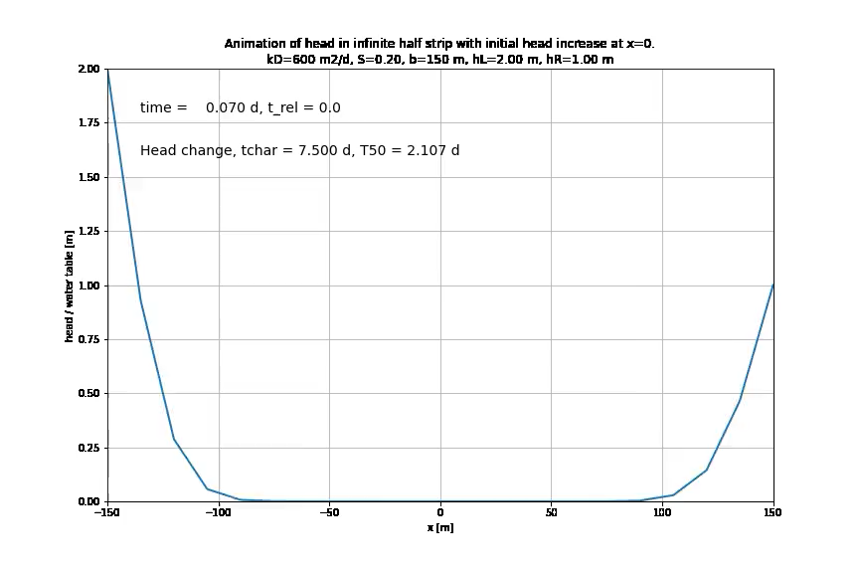

Slide 35
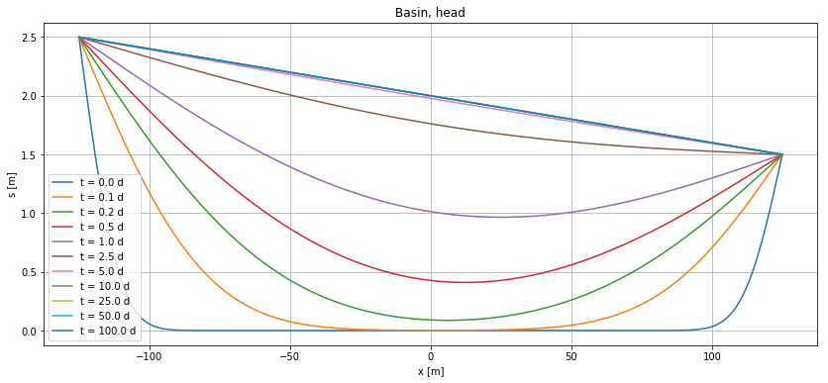
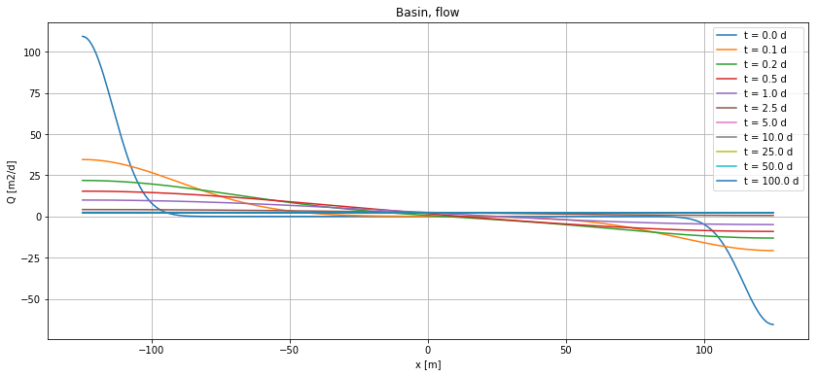
Head changes suddenly on both sides

Slide 36
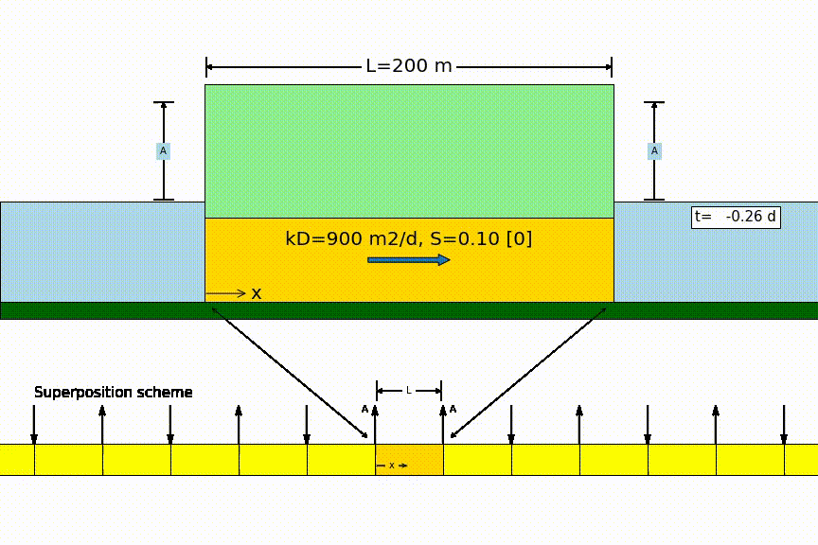
Symmetrical same sudden head change on both sides

Slide 37
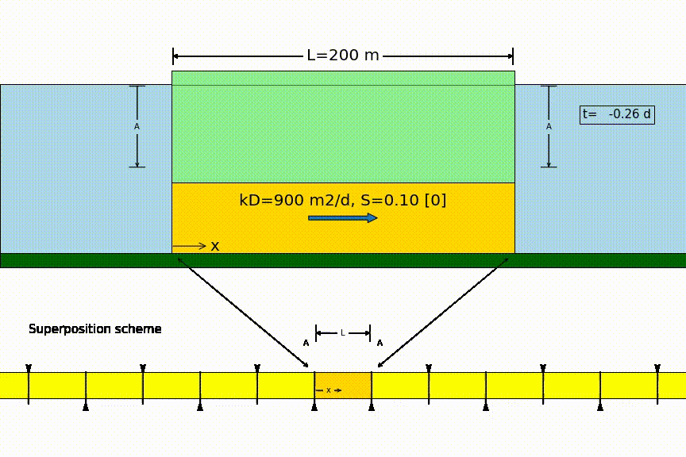
Strip drainage after sudden recharge

Slide 38
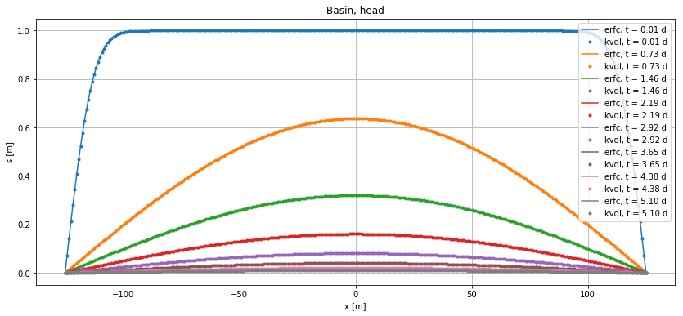
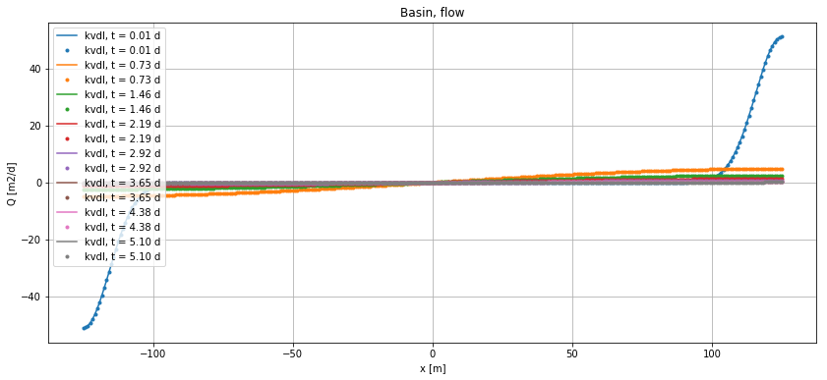
Basin drainage (two methods)

Slide 39
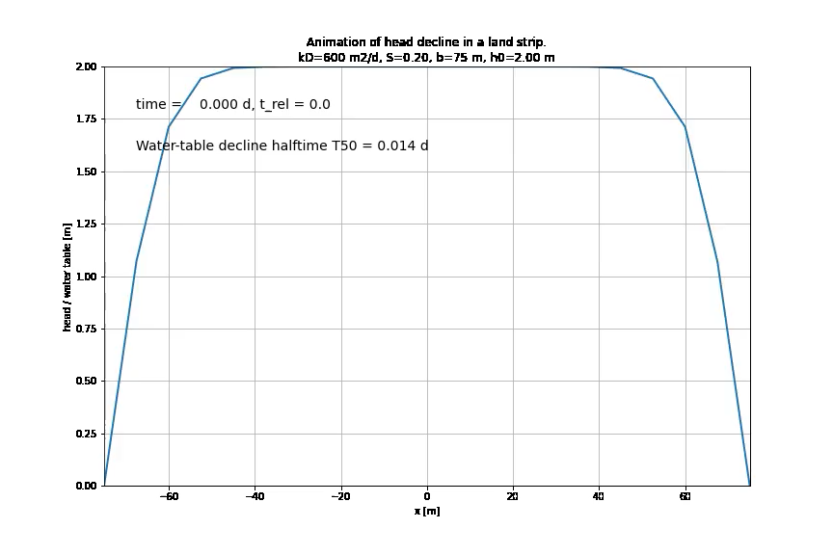

Slide 40
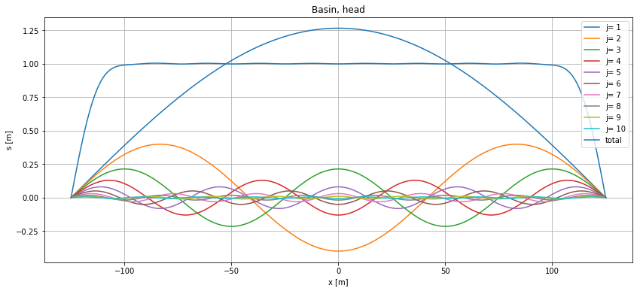
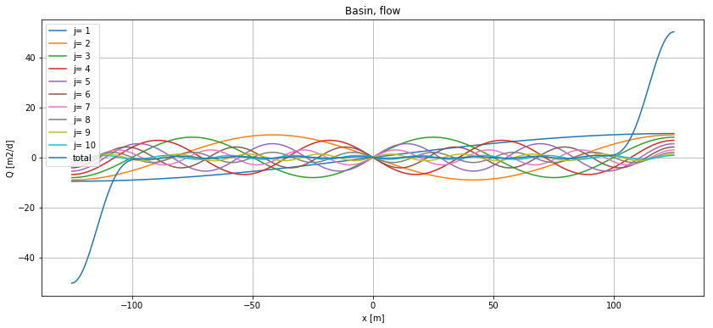
Individual terms of power series solution

Slide 41
How fast or slow is the groundwater system ??

